Slide 1



Sierra Club
100% Committed
Our mission is to leave a legacy of a livable world for our children and grandchildren.
http://climate.smiller.org/resources/UUCMC dialog.pptx
(use to give your own presentations)

Slide 2
USE CHAT to introduce Yourself
Click “Chat” (at bottom of your screen)
Then Type your name and your city

Slide 3

WHY WE WANT TO SAVE THE WORLD

Slide 4
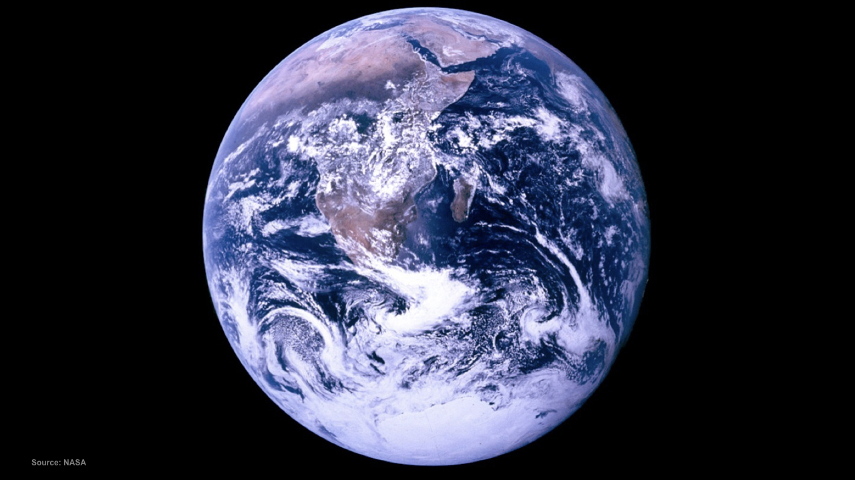
Notes:
This Truth in Ten slide deck is available to the public, not just Climate Reality Leaders, to be used in noncommercial, nonpromotional presentations broadcast on TV, streamed online, and in-person, but this slide may not be modified.
TALKING POINTS
This is the first picture of the earth fully illuminated that any of us ever saw. It was taken on the last of the Apollo missions and it changed the way that humanity thought about our common home.
It reminds us that we are all connected and that our actions have an impact on our planet.
PHOTO: “Blue Marble” photo of Earth from NASA’s Apollo 17 mission, taken as the crew was traveling toward the moon, December 7, 1972

Slide 5
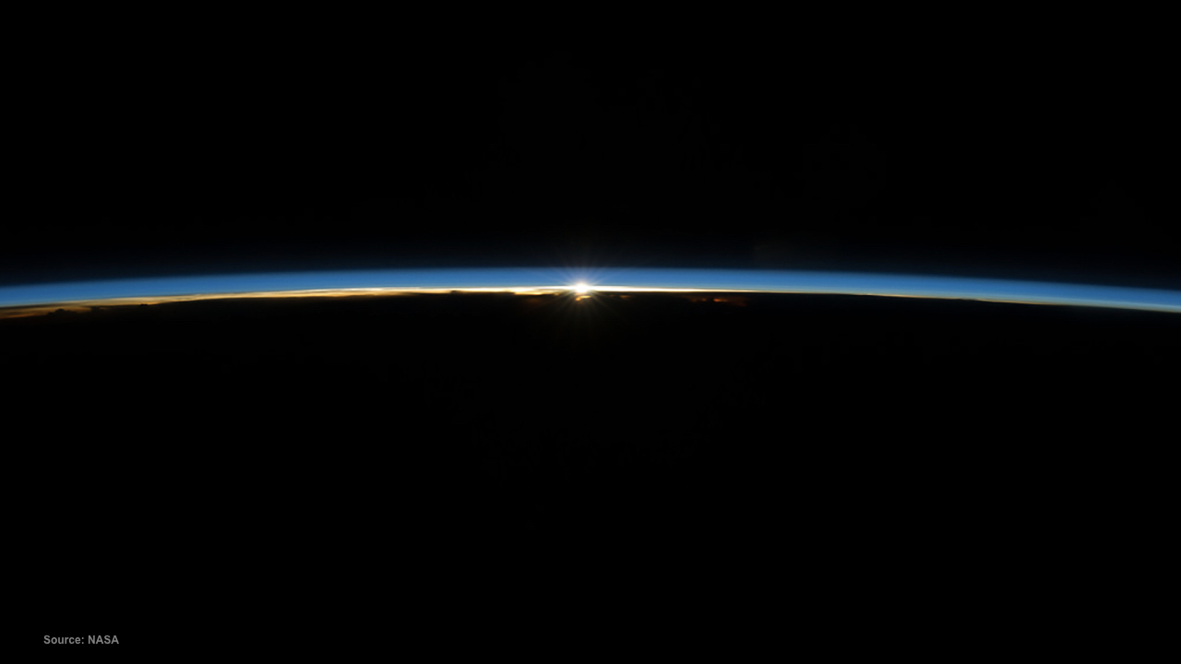
Notes:
This Truth in Ten slide deck is available to the public, not just Climate Reality Leaders, to be used in noncommercial, nonpromotional presentations broadcast on TV, streamed online, and in-person, but this slide may not be modified.
TALKING POINTS:
The sky is not a vast and limitless expanse the way it appears to us as we stand on the ground and look up.
In reality, there is just a thin shell of atmosphere surrounding the planet.
PHOTO: The sun shining over Earth’s horizon through the two lowermost layers of the atmosphere: the troposphere and the stratosphere. Photo taken from the International Space Station.

Slide 6
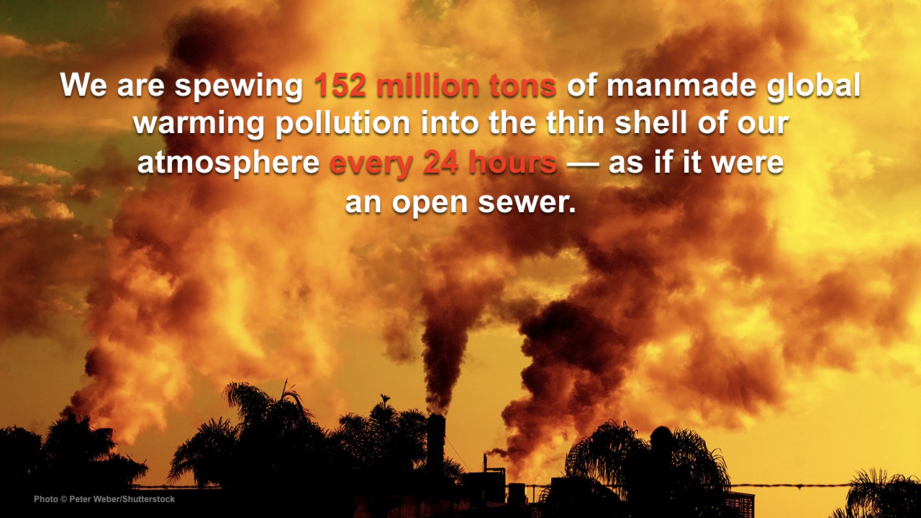
Notes:
This Truth in Ten slide deck is available to the public, not just Climate Reality Leaders, to be used in noncommercial, nonpromotional presentations broadcast on TV, streamed online, and in-person, but this slide may not be modified.
TALKING POINTS:
We are putting 152 million tons of manmade global warming pollution into the atmosphere every single day.
That pollution — especially carbon dioxide (CO2) — is building up and it’s trapping heat.

Slide 7
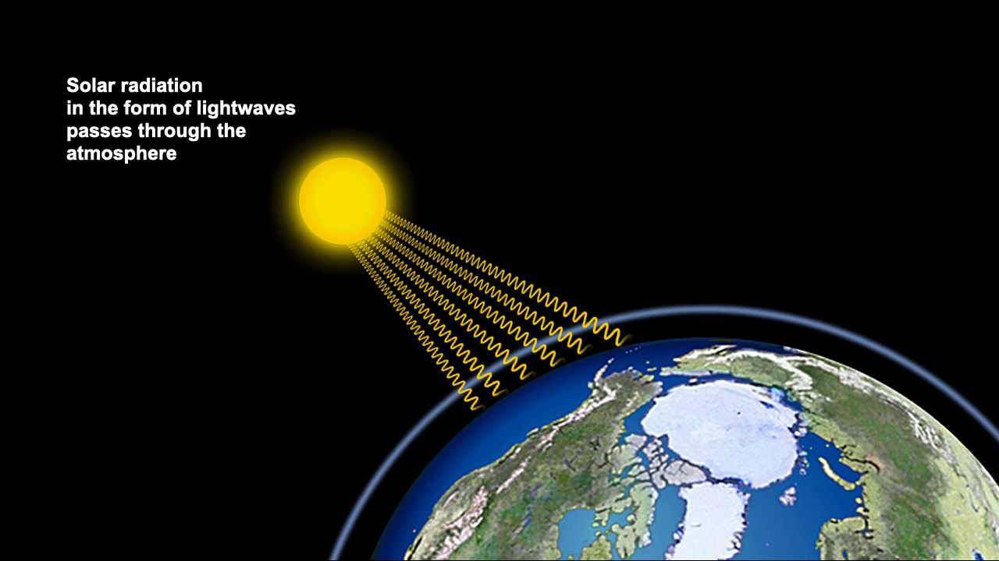
Notes:
This Truth in Ten slide deck is available to the public, not just Climate Reality Leaders, to be used in noncommercial, nonpromotional presentations broadcast on TV, streamed online, and in-person, but this slide may not be modified.
TALKING POINTS:
Here is the basic science of global warming. This has been understood by scientists since the 1800s.
Energy from the sun comes to Earth in the form of light.
That energy is absorbed by the Earth and warms it.
Some of that energy is re-radiated from the Earth in the form of heat.
Some of that outgoing heat is trapped by the atmosphere, which is a good thing — it has kept our planet at a stable temperature. Now, however, we have been “thickening” the atmosphere by filling it with heat-trapping pollution. More heat energy is trapped, and it is warming our planet at an unprecedented rate.

Slide 8
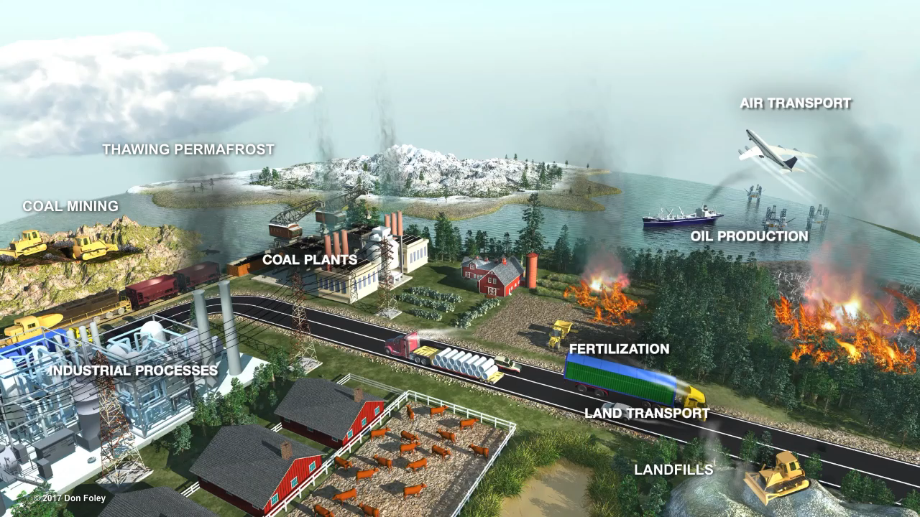
Notes:
This Truth in Ten slide deck is available to the public, not just Climate Reality Leaders, to be used in noncommercial, nonpromotional presentations broadcast on TV, streamed online, and in-person, but this slide may not be modified.
TALKING POINTS:
There are many sources of human-caused global warming pollution: agricultural practices, forest burning, transportation, and many other factors.
But the main source and cause of the rising global temperatures we are seeing today is the burning of fossil fuels.

Slide 9
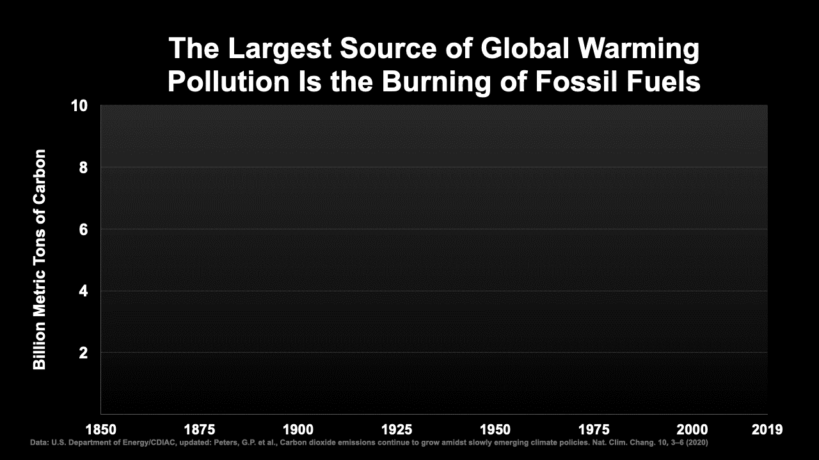
Notes:
This Truth in Ten slide deck is available to the public, not just Climate Reality Leaders, to be used in noncommercial, nonpromotional presentations broadcast on TV, streamed online, and in-person, but this slide may not be modified.
TALKING POINTS:
Fossil fuels still provide more than 80 percent of the world’s energy. Fossil fuel use and emissions have gone up dramatically since World War II.
In the last few years, there was a leveling off as the world adopted more and more clean energy solutions until another recent spike in global warming pollution.

Slide 10
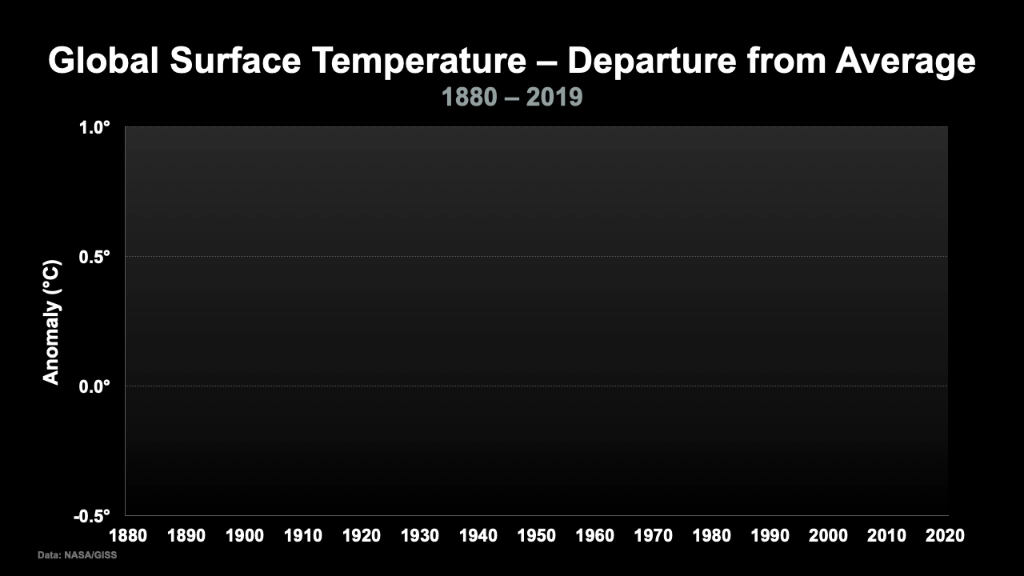
Notes:
This Truth in Ten slide deck is available to the public, not just Climate Reality Leaders, to be used in noncommercial, nonpromotional presentations broadcast on TV, streamed online, and in-person, but this slide may not be modified.
TALKING POINTS:
As a result of this pollution being trapped in the atmosphere, global temperatures have risen dramatically.

Slide 11
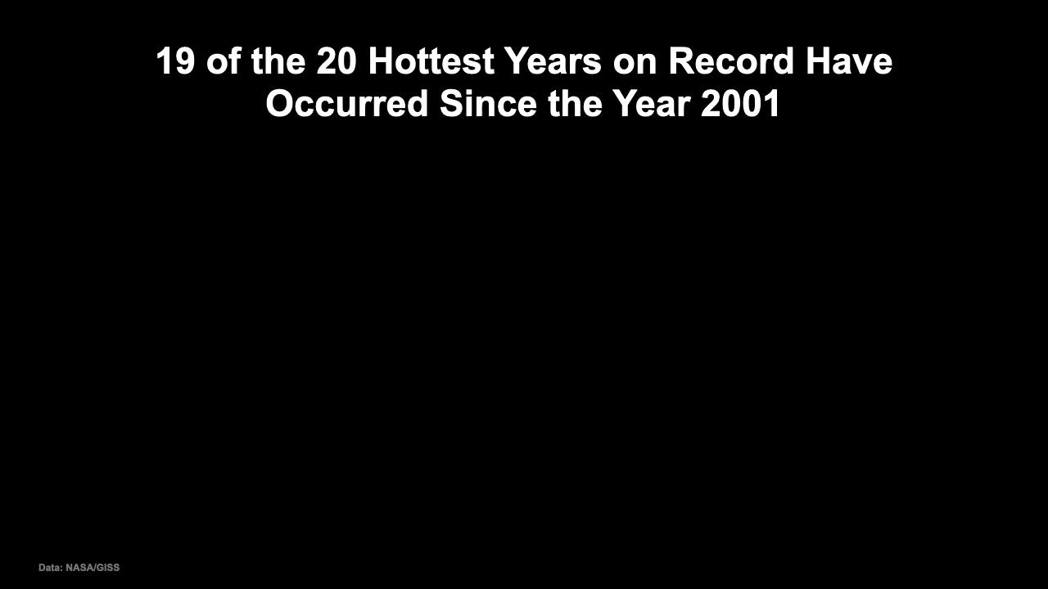
Notes:
This Truth in Ten slide deck is available to the public, not just Climate Reality Leaders, to be used in noncommercial, nonpromotional presentations broadcast on TV, streamed online, and in-person, but this slide may not be modified.
TALKING POINTS:
Nineteen of the 20 hottest years ever measured with instruments have occurred since 2001.
The hottest year of all was 2016.

Slide 12
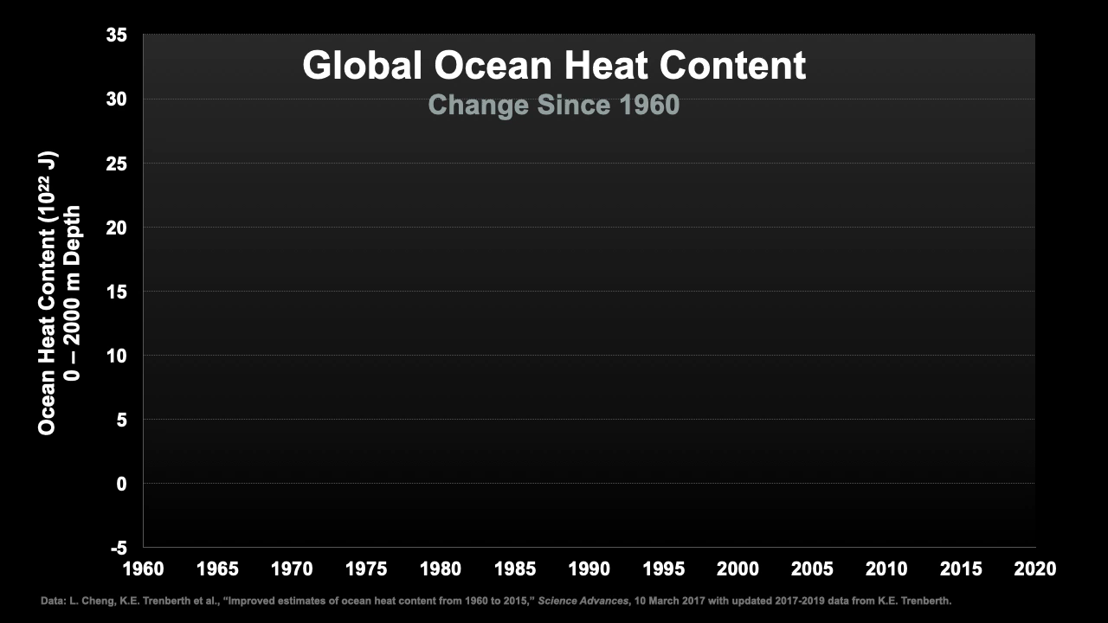
Notes:
This Truth in Ten slide deck is available to the public, not just Climate Reality Leaders, to be used in noncommercial, nonpromotional presentations broadcast on TV, streamed online, and in-person, but this slide may not be modified.
TALKING POINTS:
On a global basis, more than 90 percent of all the extra heat energy trapped by our atmosphere is going into the oceans.
This heat makes ocean-based storms like hurricanes, typhoons, and cyclones stronger and more destructive.
Half of the increase in global ocean heat content has occurred in less than 20 years.

Slide 13
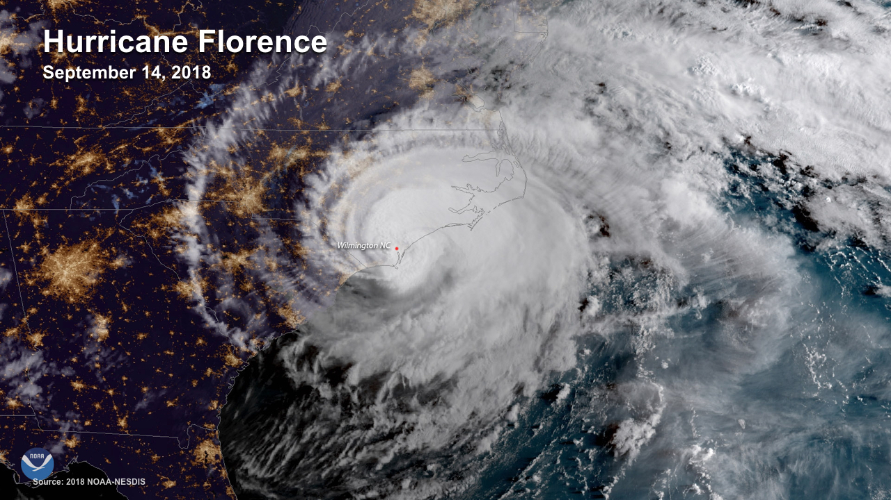
Notes:
This Truth in Ten slide deck is available to the public, not just Climate Reality Leaders, to be used in noncommercial, nonpromotional presentations broadcast on TV, streamed online, and in-person, but this slide may not be modified.
TALKING POINTS:
Hurricane Florence produced record-breaking rainfall across portions of North and South Carolina when it made landfall on the morning of September 14, 2018 near Wrightsville Beach, North Carolina.
PHOTO: A satellite image of Hurricane Florence over the coast of the Carolinas on September 14, 2018

Slide 14
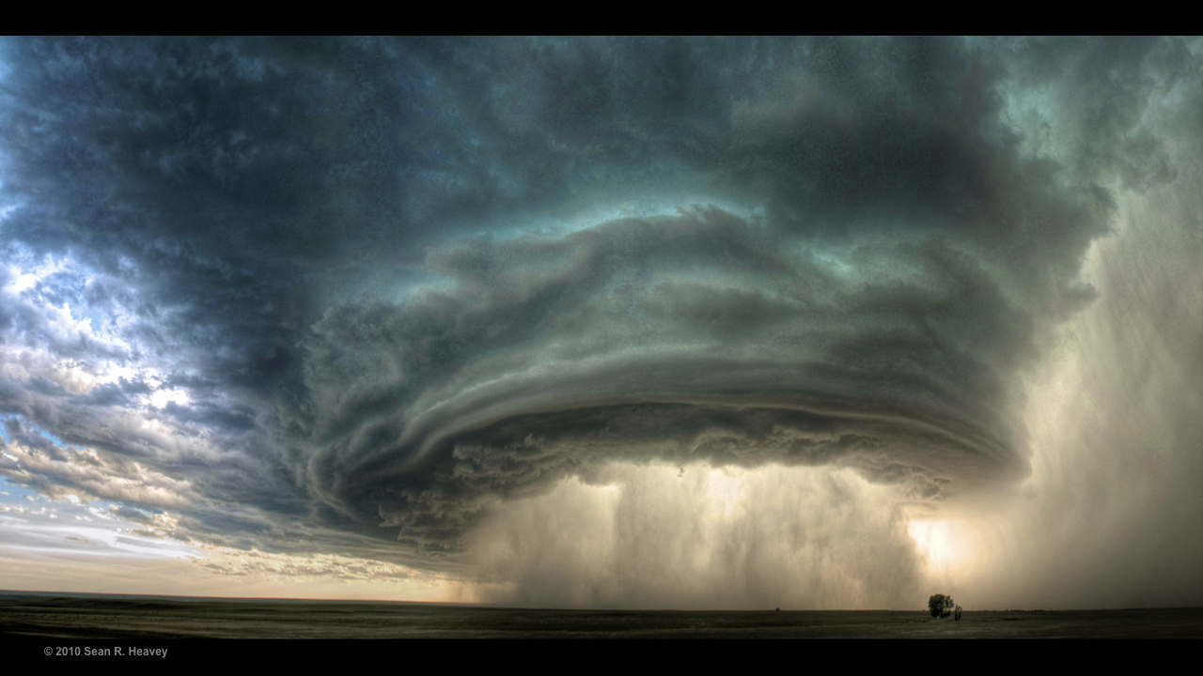
SUpercell
Notes:
This Truth in Ten slide deck is available to the public, not just Climate Reality Leaders, to be used in noncommercial, nonpromotional presentations broadcast on TV, streamed online, and in-person, but this slide may not be modified.
TALKING POINTS:
Extreme precipitation events have produced more rain and become more common since the 1950s in many regions around the world, including much of the US.
PHOTO: A supercell storm with a column of rain at its center, near Glasgow, Montana, July 28, 2010

Slide 15
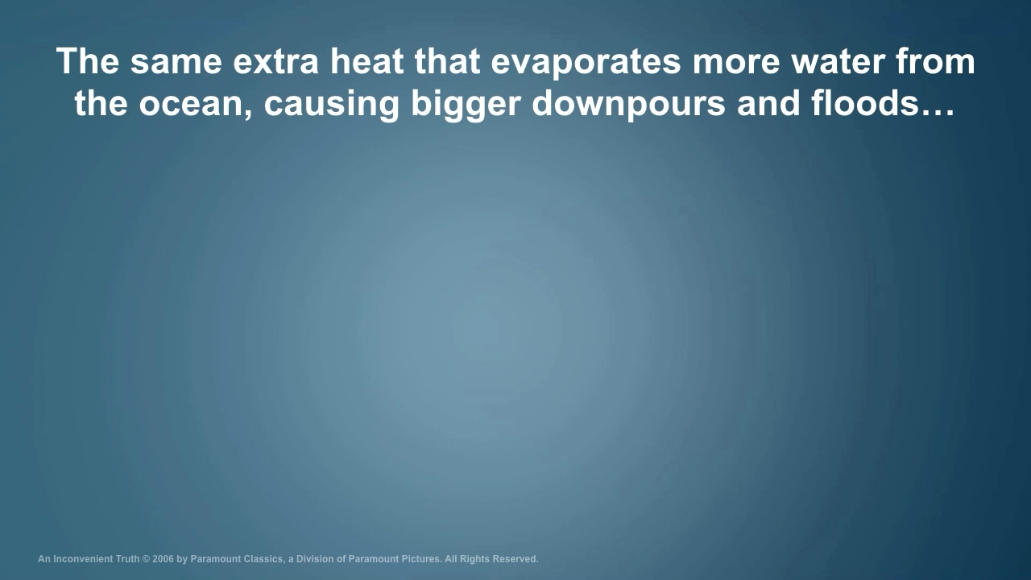
Notes:
This Truth in Ten slide deck is available to the public, not just Climate Reality Leaders, to be used in noncommercial, nonpromotional presentations broadcast on TV, streamed online, and in-person, but this slide may not be modified.
TALKING POINTS:
Sometimes people wonder how global warming can be blamed for causing more precipitation and flooding, and at the same time, more drought.
The extra heat trapped by rising levels of greenhouse gases actually leads to both. And as the climate changes, precipitation patterns also change, leaving some places with less rainfall than before.

Slide 16
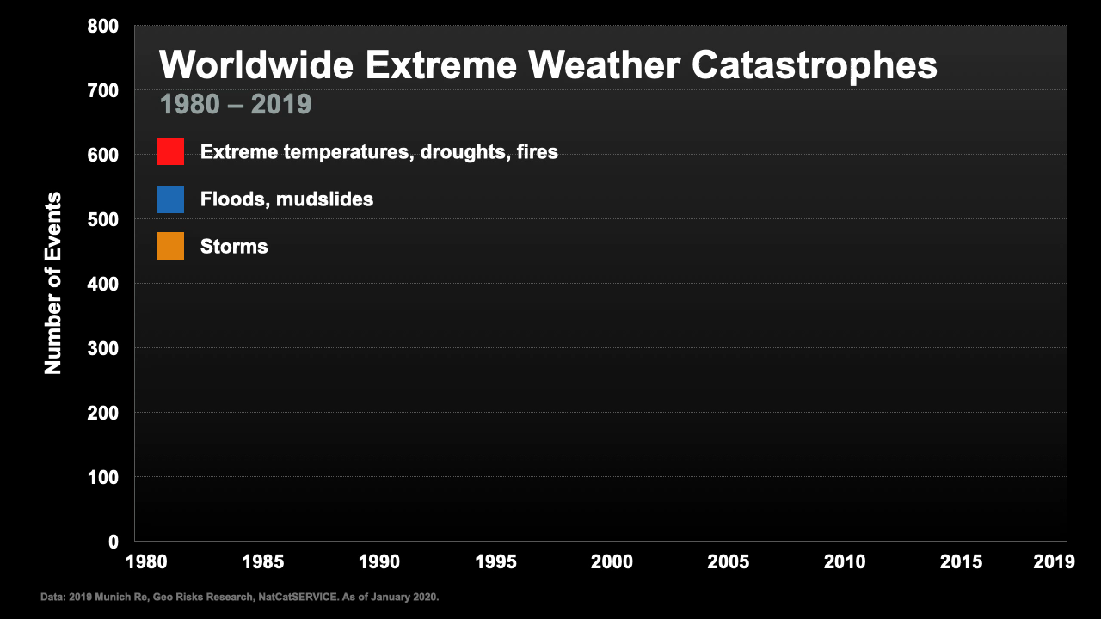
Notes:
This Truth in Ten slide deck is available to the public, not just Climate Reality Leaders, to be used in noncommercial, nonpromotional presentations broadcast on TV, streamed online, and in-person, but this slide may not be modified.
TALKING POINTS:
The number of climate-related extreme weather events has been going up worldwide, according to the insurance industry.
The last two years rank among the top 10 most expensive for overall disaster losses, with over USD $160 billion in losses in 2018 and $140 billion in 2019.

Slide 17
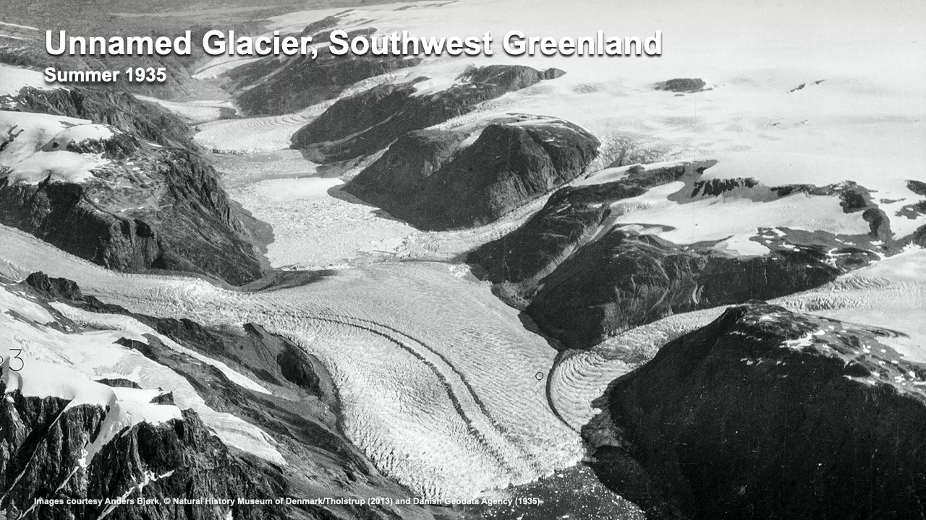
Notes:
This Truth in Ten slide deck is available to the public, not just Climate Reality Leaders, to be used in noncommercial, nonpromotional presentations broadcast on TV, streamed online, and in-person, but this slide may not be modified.
TALKING POINTS:
The first photo is of a glacier in southwest Greenland was shot in the Summer of 1935 and shows glacier ice covering the fjord walls.
The second photo is the same glacier, which had almost completely melted by 2013, not even a century later, due to rising temperatures.
NASA has precisely measured the decline in the mass of ice in both Greenland and Antarctica.
All this extra melting is raising sea levels worldwide.

Slide 18
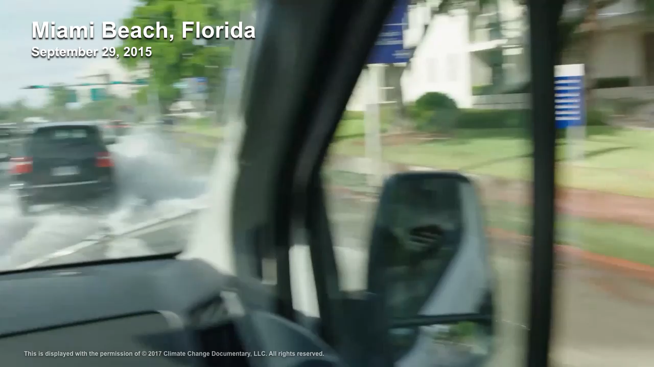
Notes:
This Truth in Ten slide deck is available to the public, not just Climate Reality Leaders, to be used in noncommercial, nonpromotional presentations broadcast on TV, streamed online, and in-person, but this slide may not be modified.
TALKING POINTS:
This flooding occurred in Miami Beach, Florida, on a sunny day with no rain.
High tides now regularly flood the streets of Miami Beach, as well as several other coastal cities around the world.
This situation will only get worse as sea levels continue to rise.

Slide 19
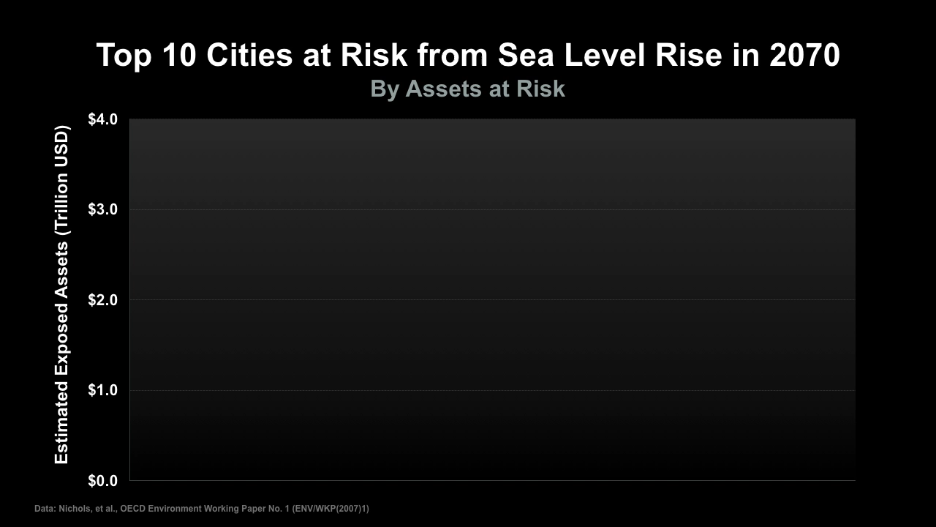
Notes:
This Truth in Ten slide deck is available to the public, not just Climate Reality Leaders, to be used in noncommercial, nonpromotional presentations broadcast on TV, streamed online, and in-person, but this slide may not be modified.
TALKING POINTS:
Miami is the number one city at risk in terms of assets at risk – along with Guangzhou, China, New York/Newark, and others.

Slide 20
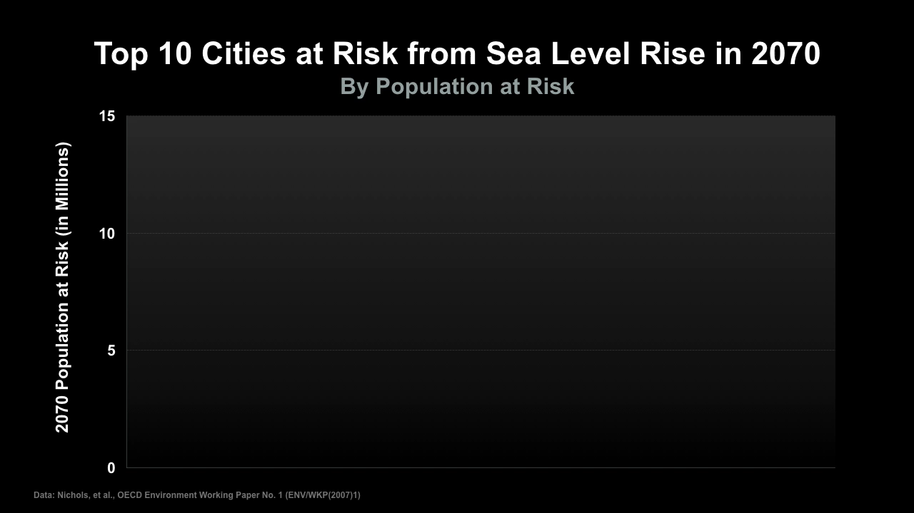
Notes:
This Truth in Ten slide deck is available to the public, not just Climate Reality Leaders, to be used in noncommercial, nonpromotional presentations broadcast on TV, streamed online, and in-person, but this slide may not be modified.
TALKING POINTS:
Looking at cities at risk by population, we see that many huge cities in developing countries are very much in danger.
If parts of these cities become uninhabitable, where will the people who live there go?

Slide 21

Notes:
This Truth in Ten slide deck is available to the public, not just Climate Reality Leaders, to be used in noncommercial, nonpromotional presentations broadcast on TV, streamed online, and in-person, but this slide may not be modified.
TALKING POINTS:
The Department of Defense in the United States has long warned about refugee crises connected to the climate crisis, as well as pandemic diseases, water shortages, and food shortages.

Slide 22
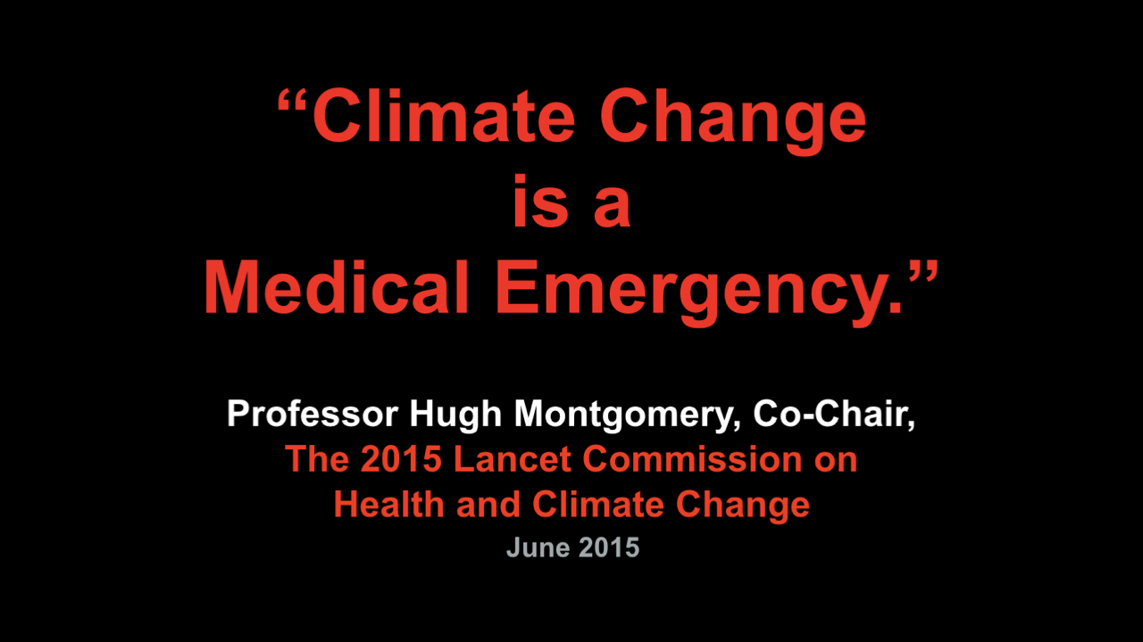
Notes:
This Truth in Ten slide deck is available to the public, not just Climate Reality Leaders, to be used in noncommercial, nonpromotional presentations broadcast on TV, streamed online, and in-person, but this slide may not be modified.
TALKING POINTS:
Infectious diseases, heat stress, air pollution, and waterborne diseases are all influenced by a changing climate – and not in our favor.

Slide 23
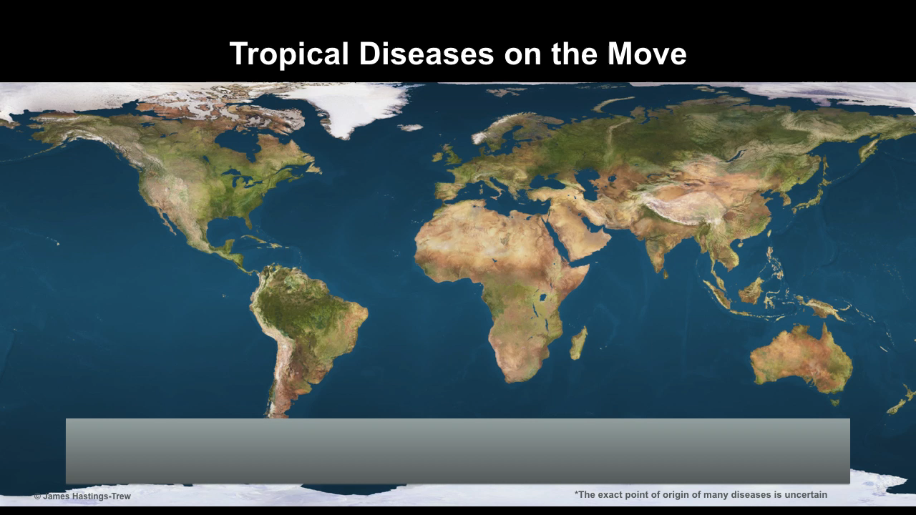
Notes:
This Truth in Ten slide deck is available to the public, not just Climate Reality Leaders, to be used in noncommercial, nonpromotional presentations broadcast on TV, streamed online, and in-person, but this slide may not be modified.
TALKING POINTS:
Warmer temperatures have an impact on the spread of tropical diseases. Modern transportation and air travel play a part, but the potential range for many diseases expands as regions farther and farther poleward get warmer.
This means there are more and more places where a disease like Zika can take root.

Slide 24

Notes:
This Truth in Ten slide deck is available to the public, not just Climate Reality Leaders, to be used in noncommercial, nonpromotional presentations broadcast on TV, streamed online, and in-person, but this slide may not be modified.
TALKING POINTS:
The main mosquito that spreads Zika (and dengue and yellow fever) is now covering a wider range in a warmer, wetter world.
In warmer temperatures, the virus incubates faster and mosquitos breed more and are able to transmit the disease longer.
The health impacts of the climate crisis are often overlooked, but will affect millions of people.
PHOTO: An Aedes aegypti mosquito feeding

Slide 25
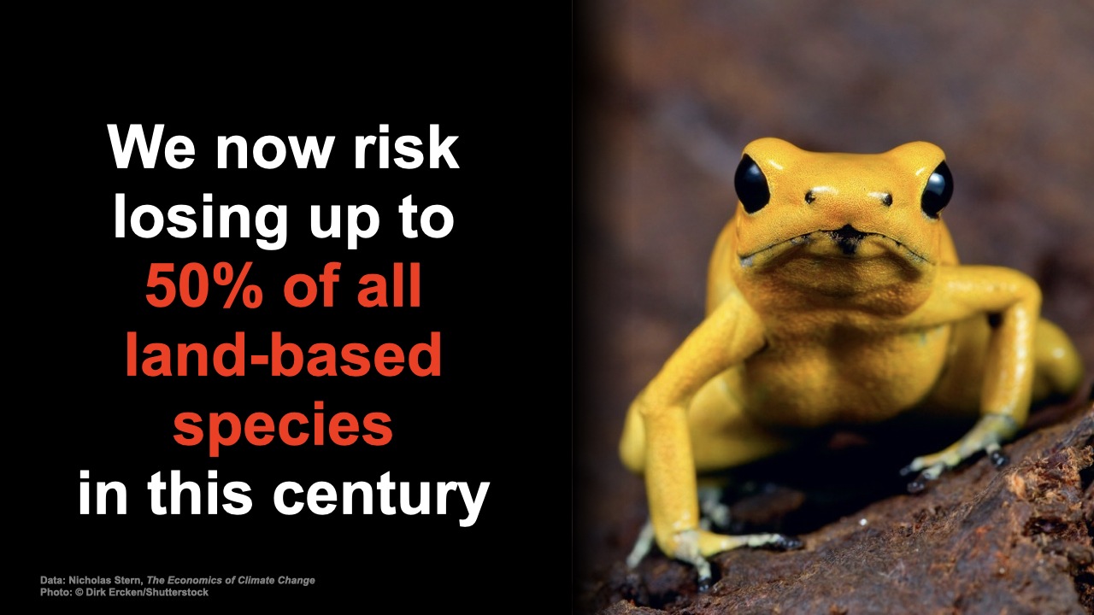
Notes:
This Truth in Ten slide deck is available to the public, not just Climate Reality Leaders, to be used in noncommercial, nonpromotional presentations broadcast on TV, streamed online, and in-person, but this slide may not be modified.
TALKING POINTS:
Climate change, along with other factors such as ecosystem loss, is contributing to the worst extinction event since the extinction of the dinosaurs 65 million years ago.
PHOTO: Endangered golden poison frog

Slide 26
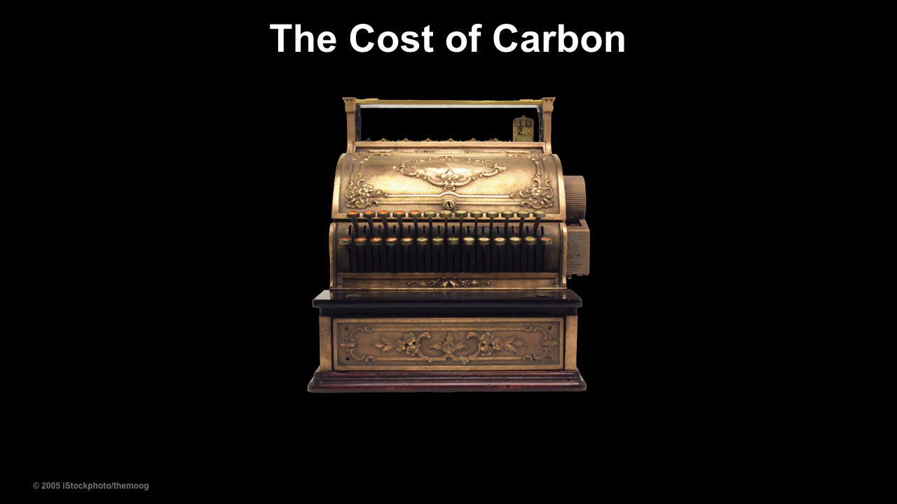
Notes:
This Truth in Ten slide deck is available to the public, not just Climate Reality Leaders, to be used in noncommercial, nonpromotional presentations broadcast on TV, streamed online, and in-person, but this slide may not be modified.
TALKING POINTS:
All of these threats – including many we haven’t even covered here, and the fact that the World Economic Forum says climate change is the number one threat to the global economy – help to answer the question: Must we change?

Slide 27

We will Deploy a Poll
a quick survey:
How will your Grandchildren be impacted by climate change?
not at all .. a little ……… A lot ….. severely impacted
Notes:
This Truth in Ten slide deck is available to the public, not just Climate Reality Leaders, to be used in noncommercial, nonpromotional presentations broadcast on TV, streamed online, and in-person, but this slide may not be modified.
TALKING POINTS:
So, do we have to change? Yes, we do!

Slide 28
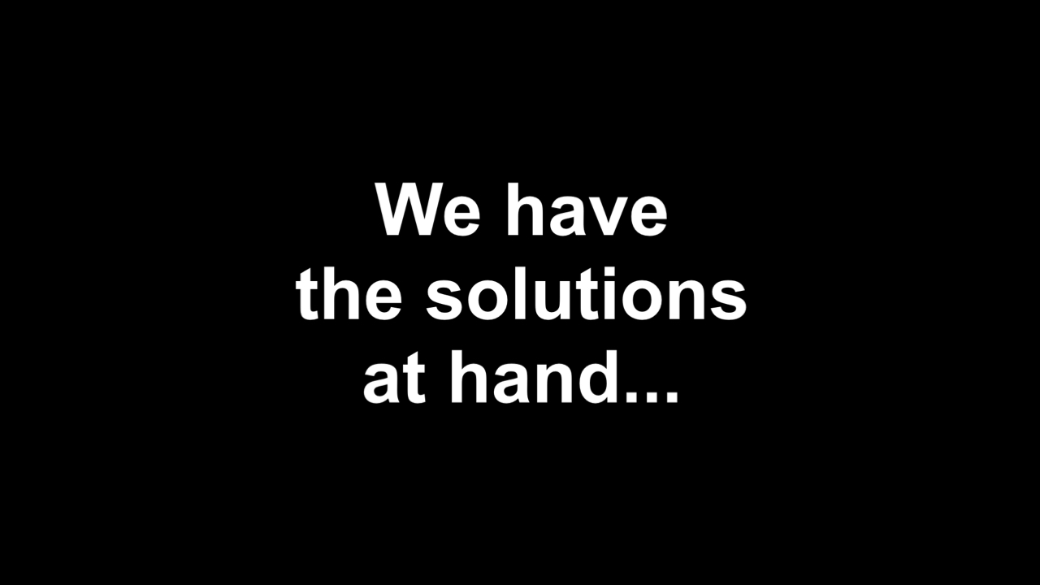
Notes:
This Truth in Ten slide deck is available to the public, not just Climate Reality Leaders, to be used in noncommercial, nonpromotional presentations broadcast on TV, streamed online, and in-person, but this slide may not be modified.
TALKING POINTS:
We’ve got the solutions available to us now.

Slide 29
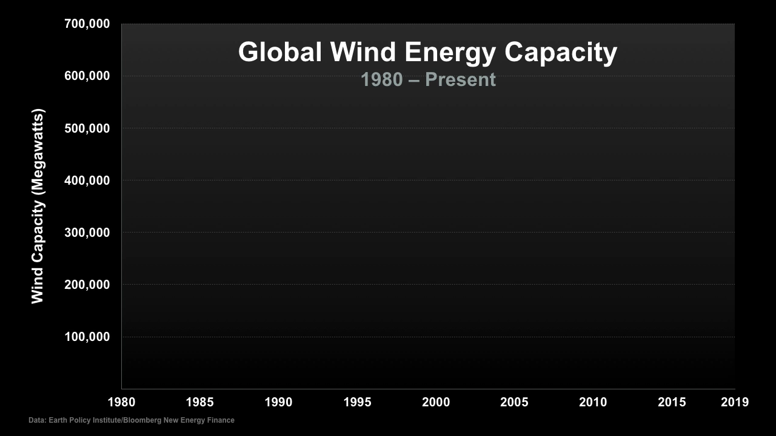
Notes:
This Truth in Ten slide deck is available to the public, not just Climate Reality Leaders, to be used in noncommercial, nonpromotional presentations broadcast on TV, streamed online, and in-person, but this slide may not be modified.
TALKING POINTS:
The growth in wind energy being built around the world is an exponential curve.

Slide 30
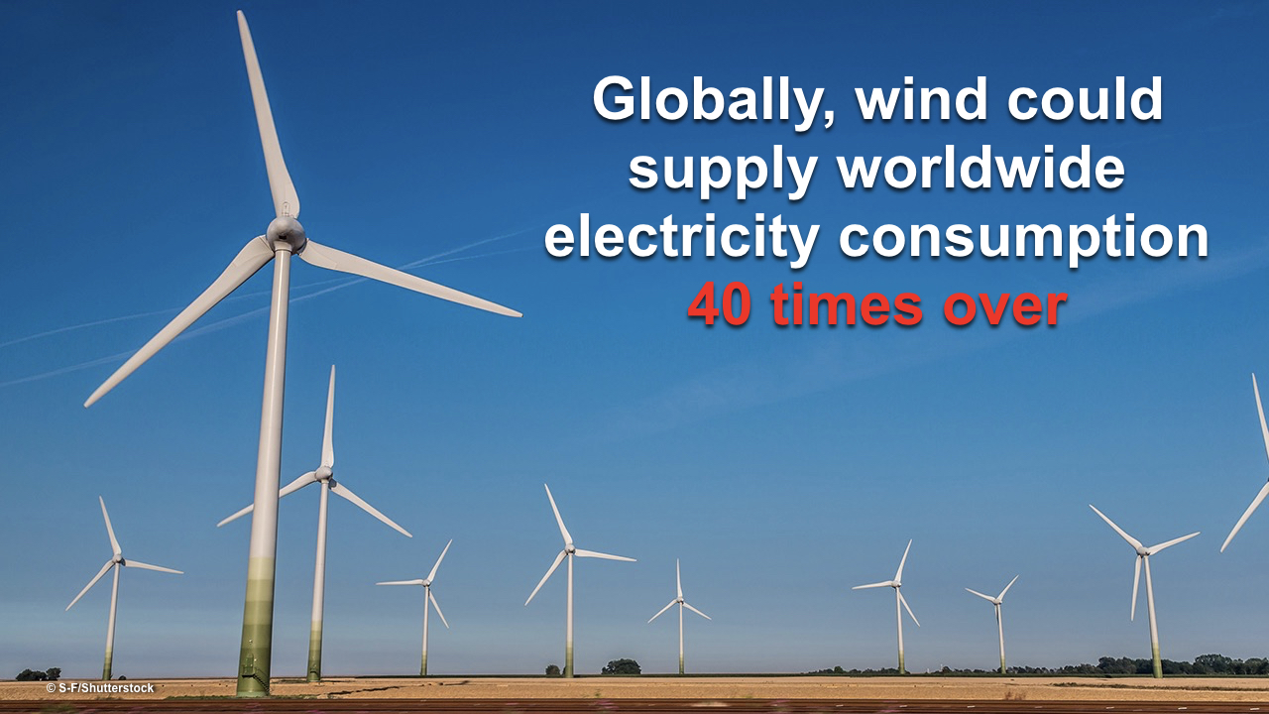
Notes:
This Truth in Ten slide deck is available to the public, not just Climate Reality Leaders, to be used in noncommercial, nonpromotional presentations broadcast on TV, streamed online, and in-person, but this slide may not be modified.
TALKING POINTS:
Wind energy could supply 40 times more electricity than the entire world currently uses.
Photo: A wind farm on a summer day

Slide 31
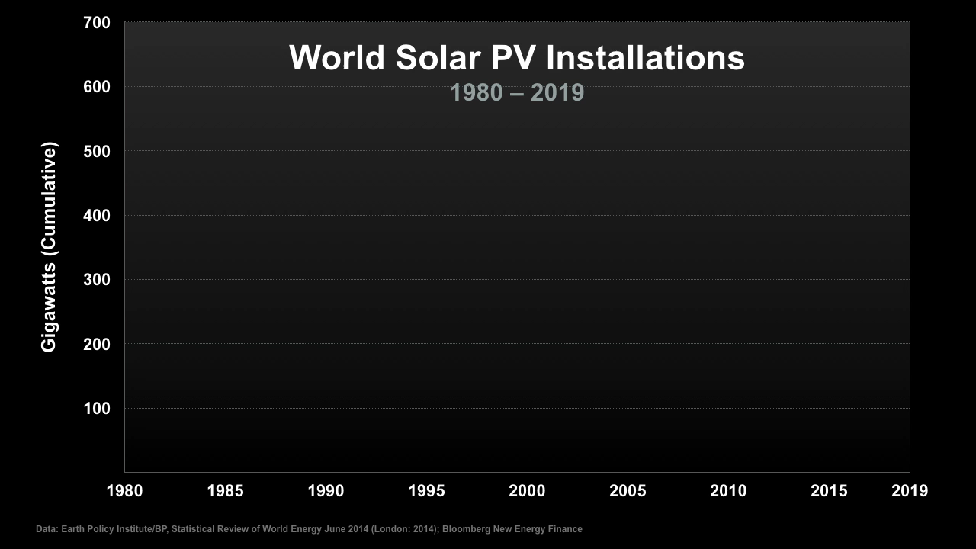
Notes:
This Truth in Ten slide deck is available to the public, not just Climate Reality Leaders, to be used in noncommercial, nonpromotional presentations broadcast on TV, streamed online, and in-person, but this slide may not be modified.
TALKING POINTS:
Even more dramatically than with wind, we see an exponential curve in the amount of solar energy installed around the world.

Slide 32
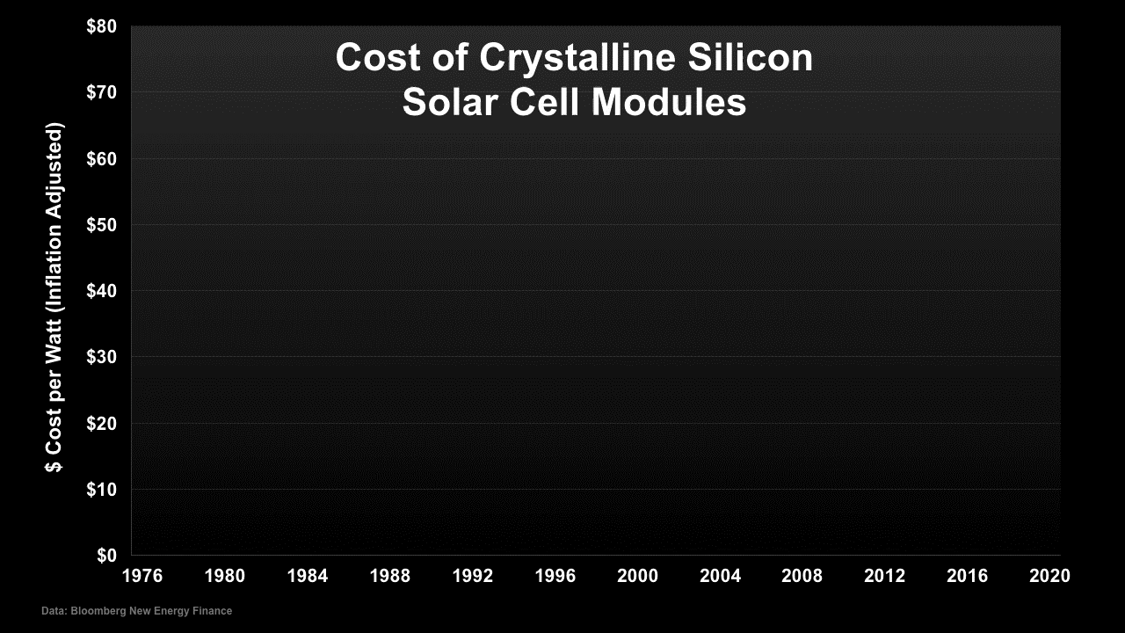
Notes:
This Truth in Ten slide deck is available to the public, not just Climate Reality Leaders, to be used in noncommercial, nonpromotional presentations broadcast on TV, streamed online, and in-person, but this slide may not be modified.
TALKING POINTS:
Just as we have seen with other technologies, such as computer chips and cell phones, solar costs have fallen dramatically. In some regions, solar energy is less than half the cost of electricity from burning coal.

Slide 33
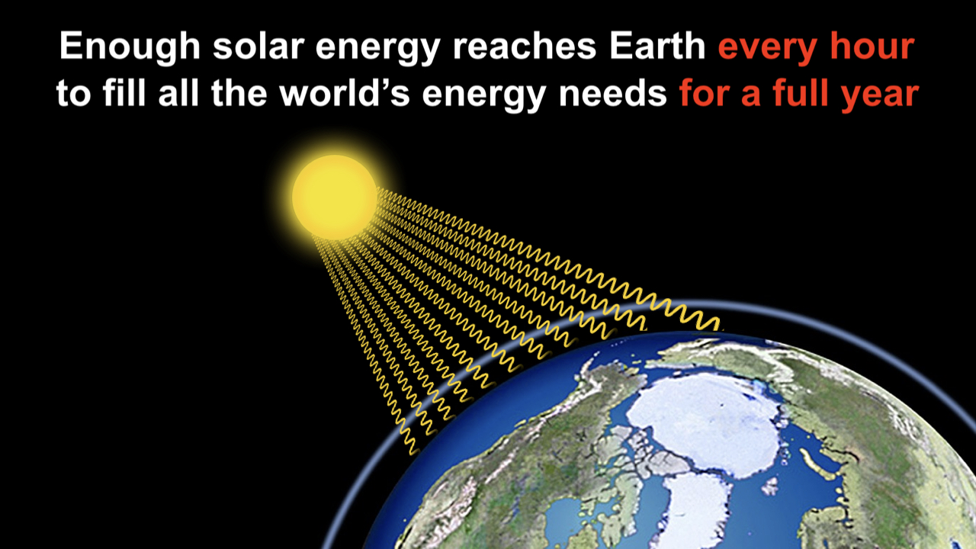
Notes:
This Truth in Ten slide deck is available to the public, not just Climate Reality Leaders, to be used in noncommercial, nonpromotional presentations broadcast on TV, streamed online, and in-person, but this slide may not be modified.
TALKING POINTS:
Every hour the Earth gets as much energy from the sun as we need to run the entire global economy for a year.
If we can increase the fraction of this energy that we harvest and use, we can make a lot of progress towards solving the climate crisis and helping local economies at the same time.

Slide 34
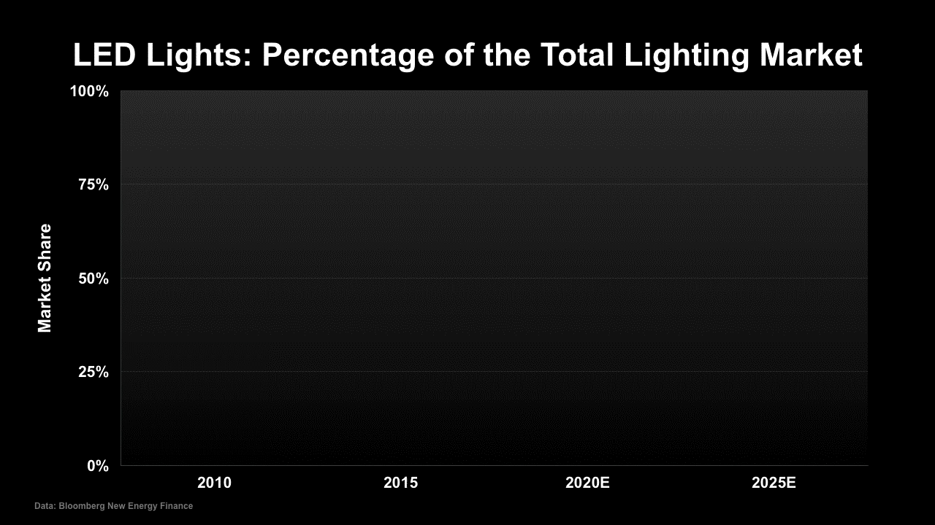
Notes:
This Truth in Ten slide deck is available to the public, not just Climate Reality Leaders, to be used in noncommercial, nonpromotional presentations broadcast on TV, streamed online, and in-person, but this slide may not be modified.
TALKING POINTS:
Within the next eight years, highly efficient LED lights are predicted to virtually take over the market.
Energy-efficient technologies like LEDs save people money and help to reduce emissions by cutting down on the amount of electricity we use.

Slide 35
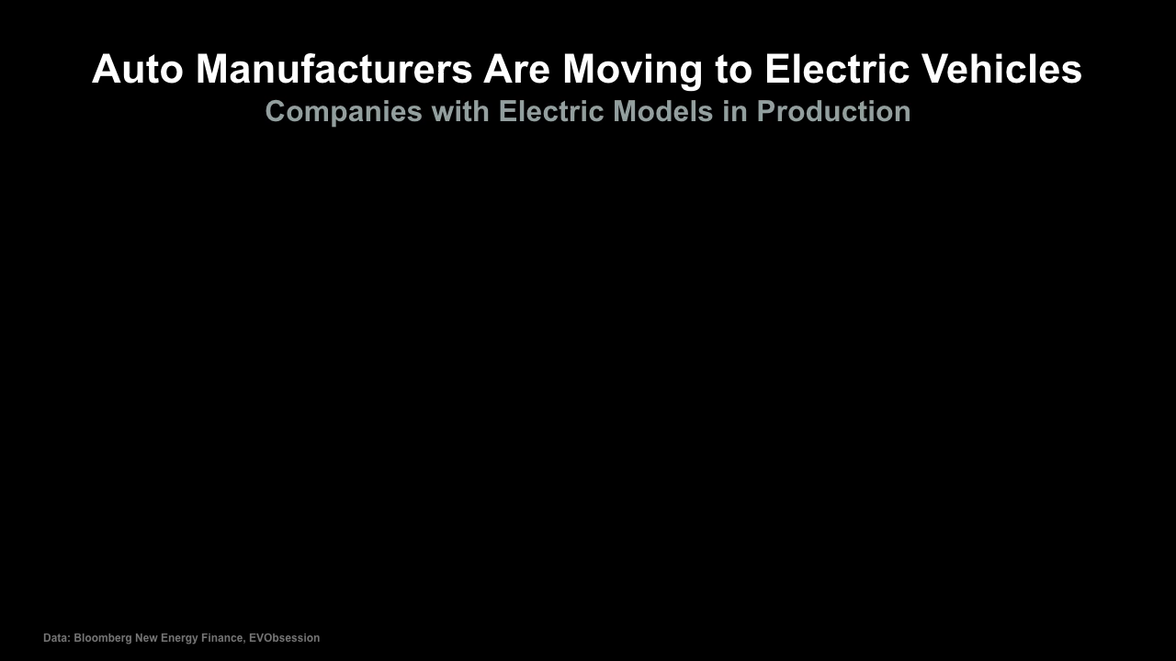
Notes:
This Truth in Ten slide deck is available to the public, not just Climate Reality Leaders, to be used in noncommercial, nonpromotional presentations broadcast on TV, streamed online, and in-person, but this slide may not be modified.
TALKING POINTS:
All these automobile manufacturers are now offering or preparing to offer electric vehicles.
This is another part of the sustainability revolution.

Slide 36

Notes:
This Truth in Ten slide deck is available to the public, not just Climate Reality Leaders, to be used in noncommercial, nonpromotional presentations broadcast on TV, streamed online, and in-person, but this slide may not be modified.
TALKING POINTS:
What about that final question: Will we change?
Here, too, there’s exciting news.

Slide 37
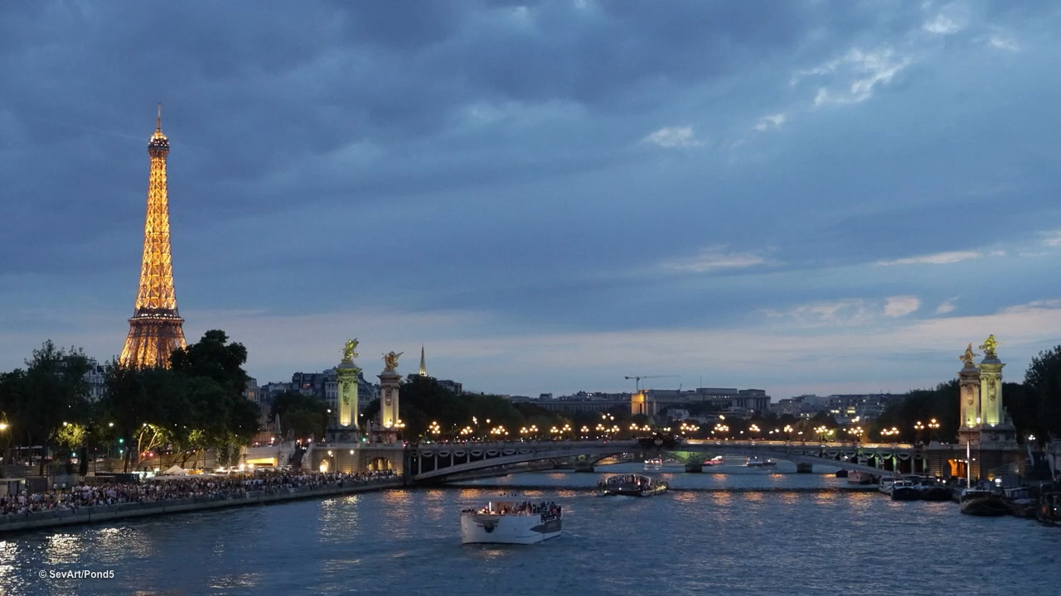
Notes:
This Truth in Ten slide deck is available to the public, not just Climate Reality Leaders, to be used in noncommercial, nonpromotional presentations broadcast on TV, streamed online, and in-person, but this slide may not be modified.
TALKING POINTS:
In December of 2015, at the Paris climate negotiations, every nation in the world agreed to phase down greenhouse gas pollution to net zero emissions as early in the second half of this century as possible.
Climate action isn’t just about what countries do. We all have to take the lead on climate. We’re seeing corporations, states and provinces, and cities commit to reducing emissions.

Slide 38

Notes:
This Truth in Ten slide deck is available to the public, not just Climate Reality Leaders, to be used in noncommercial, nonpromotional presentations broadcast on TV, streamed online, and in-person, but this slide may not be modified.
TALKING POINTS:
We’re seeing marches and demonstrations and demands at the ballot box for the changes necessary to solve this crisis.

Slide 39
CLIMATE CHANGE in NJ
May 7, 2020 Webinar
NJDEP Climate Change Resiliency StratStrategy
Strategy
NJ DEP
Climate Change Resiliency Strategy, May 7, 2020 30https://www.nj.gov/dep/climatechange/resilience.html
6 minute 30 second CLIMATE Projections for NJ:
https://youtu.be/PweLswg58i8
https://www.nj.gov/dep/climatechange/resilience.html

Slide 40
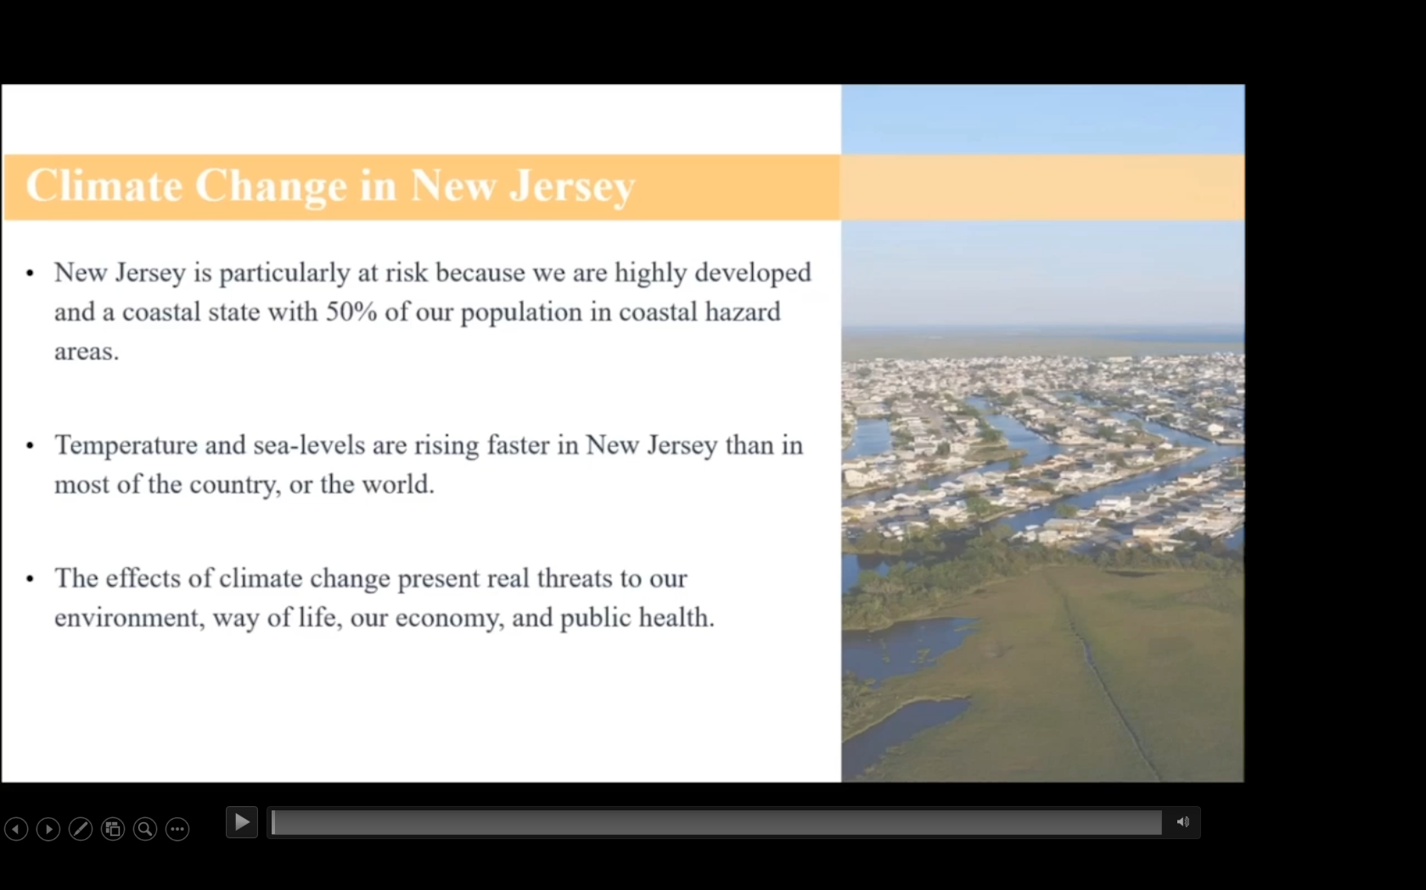
6 minute 30 second CLIMATE Projections for NJ
not included in this PPTx file.; View at:
https://youtu.be/PweLswg58i8
Notes:
6 minute 30 second CLIMATE Projections for NJ are not linked to this PPTX file
Instead, view at https://youtu.be/PweLswg58i8
(To reduce file size, this video is removed from this PowerPoint flide)

Slide 41
Poll – were you aware of all these forecasted future climate changes in NJ?
None
Some
Most
All
Enter on CHAT: what surprised you the most

Slide 42
New Jersey’s Clean Energy Initiatives
NJ 2019 Energy Master Plan: 100% Clean Energy by 2050
Rejoin Regional Greenhouse Gas Initiative (RGGI)
Join US Climate Alliance
Renewable Energy Law
  Renewable Energy Standard (graduated to 50% by 2030)
  Solar, Offshore Wind, Energy Efficiency, Energy Storage
  Energy Aggregation, Community Solar, EVs
Notes:
Gov Murphy Executive Order #28 on 5/23/2018: 50% renewable electricity by 2030 and 100% Clean Energy by 2050 –
rollout is being nailed down by 2019 Energy Master Plan, to be final by end of year.
We will have 3500 MW of Offshore Wind, new solar programs, Energy Storage AND
CLICK
RGGI provides carbon trading across east cost states. NJ is officially back in RGGI as of Jun 2019 and stands to benefit financially from credits that could be used for additional renewable projects.
BAN OFFSHORE DRILLING : we cant actually control drilling in Federal Waters (beyond 3 miles or so). BUT WE CAN and ARE PROHIBITING any use of land-based facilities – no ships, pipelines, etc.
12/18/2018 NJ joined with 9 other regional and mid-atlantic states in the “Transportation and Climate Initiative” (TCI) to within 1 year, define a low-carbon transportation policy

Slide 43
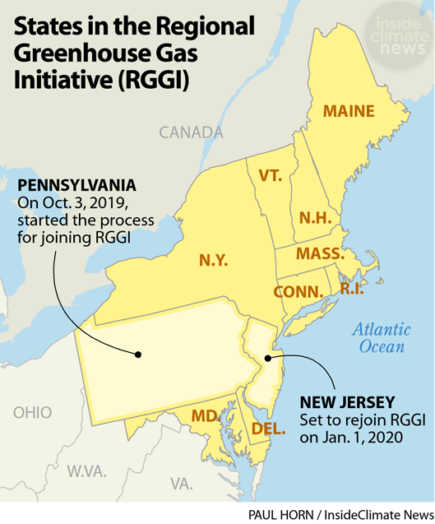
NJ Joins RGGI 1/1/2020
RGGI Results To Date:
-Carbon Emissions down 46%
-Electricity prices down 5.7%
(US rates up 7.6%)
-State economies grew faster than all other US states
-$3.2B revenue from carbon permit auction system
https://insideclimatenews.org/news/03102019/pennsylvania-rggi-coal-gas-power-plant-emissions-carbon-cap-trade-regulation
Notes:
NJ rejoins RGGI on 1/1/2020, to reap the beneifts:
READ
https://insideclimatenews.org/news/03102019/pennsylvania-rggi-coal-gas-power-plant-emissions-carbon-cap-trade-regulation
PA is a big deal: the nation’s #2 nat gas producer; #3 coal producer
PA gov says “we need to get serious” about the climate crisis:
"If we want a Pennsylvania that is habitable for our children and grandchildren, where temperatures aren't in the 90s in October ... where flooding doesn't destroy homes and businesses over and over again, we need to get serious right now about addressing the climate crisis," Gov Wolf said
The Gov of VA, a Dem, tried to join RGGI, but was blocked earlier this year by the state’s Republican-controlled legislature

Slide 44
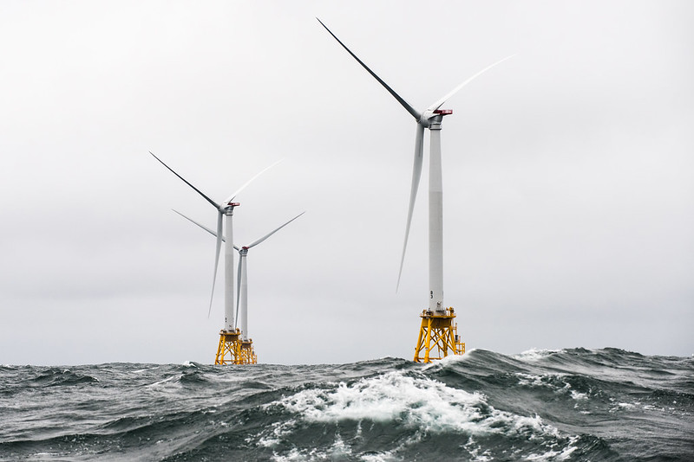
NJ has goal of 7,500 MW from offshore wind by 2035
Notes:
A number of world’s countries have demonstrated they can switch to 100% wind and solar. Read “NJ goal of 3500MW….”In fact, I read those offshore sites have potential for further future expansion by 3 or 4 times the wind power.

Slide 45
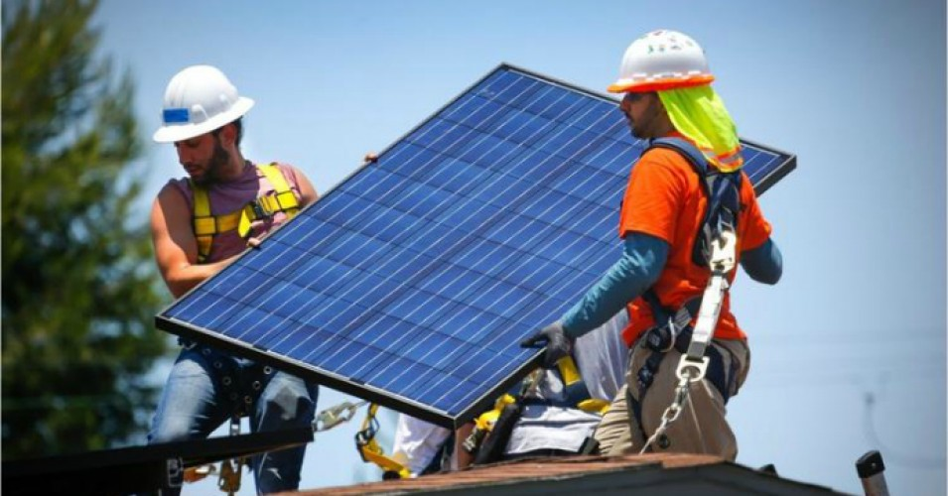
NJ Top 7 Solar States: 123,000 Solar Panel installs
Notes:
SOURCE: 5/2020: https://www.nj.gov/dep/aqes/opea-solar.html
NJ has dropped a little, but is now #6 in the nation in rooftop solar.
NJDEP 5/2020 web site: (123,000 individual solar PV installations. According to the Solar Energy Industries Association (SEIA), New Jersey is ranked 7th in the United States for totaled installed solar PV capacity, behind California, North Carolina, Arizona, Nevada, Florida and Texas. New Jersey is ranked 1st on a total installed solar PV capacity per square mile basis; demonstrating New Jersey’s commitment to solar energy despite the state’s limited geographic footprint.

Slide 46
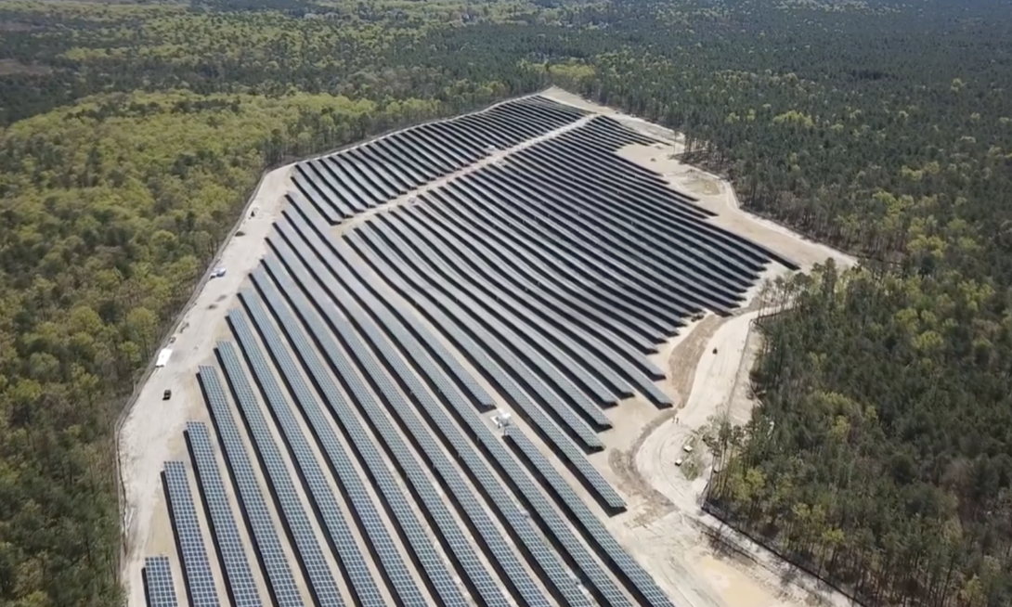
Solar at Six Flags Great Adventure
Notes:
NJDEP ((5/2020): According to the Solar Energy Industries Association (SEIA), New Jersey is ranked 7th in the United States for totaled installed solar PV capacity, behind California, North Carolina, Arizona, Nevada, Florida and Texas. New Jersey is ranked 1st on a total installed solar PV capacity per square mile basis; demonstrating New Jersey’s commitment to solar energy despite the state’s limited geographic footprint.
Across NJ, we have companies like “KDC Solar”, who specialize in erecting immense solar fields, in partnership with large businesses. “KDC Solar” offers to erect solar systems, with no up-front cost, and then sell the electricity to the business at a BIG savings over JCP&L. This is called a “Purchase Power Agreement” or “PPA” – keep your eyes open- this is happening ALL OVER THE US.
It is very similar to a homeowner, renting their rooftop to a solar installer for $1. That installer then installs and owns the rooftop solar, and sells low cost electricity to the homeowner.

Slide 47
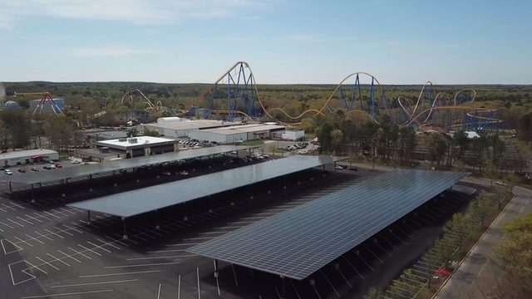
Six Flags Solar Canopy over Parking
Notes:
Similarly, Sea Brook Village in TintonFalls (15 acres of solar)
CentraState Hospital, Freehold (26 acres 6.3MW; 8.1 million KWH/Yr.)
In Middletown, we advocate for the Middletown train station parking to be covered with a solar Canopy, like the photo. The Middletown Administrator is using an energy consultant to look into pricing.

Slide 48
Municipality Clean energy
& climate change impact

Slide 49
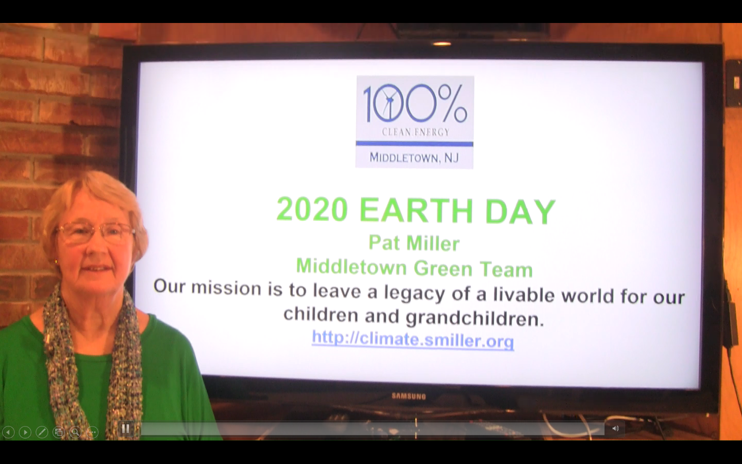
Pat Miller recorded a 5 min 30sec video for the April 22, 2020, 50th anniversary of “Earth Day”. This video is stored at https://youtu.be/m6lad_mYVbI
Notes:
To reduce file size, this video is deleted from this slide deck.
The video is viewable at https://youtu.be/m6lad_mYVbI

Slide 50
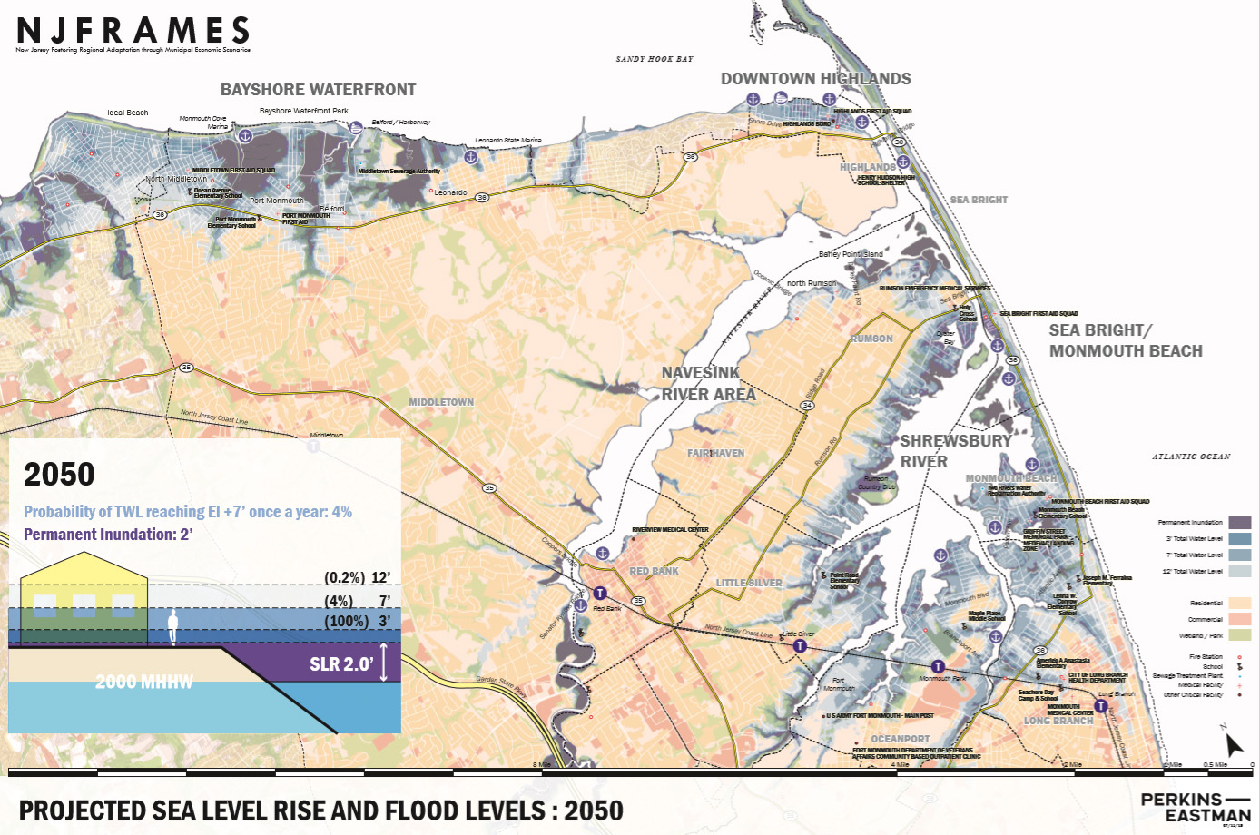
PROJECTED SEA LEVEL RISE-2050
Notes:
2050
PURPLE: Sea Level
Light Blue: 4% probability of 7 foot rise in water once per year
Dark Blue: 100% probability of 3 foot rise once per year

Slide 51
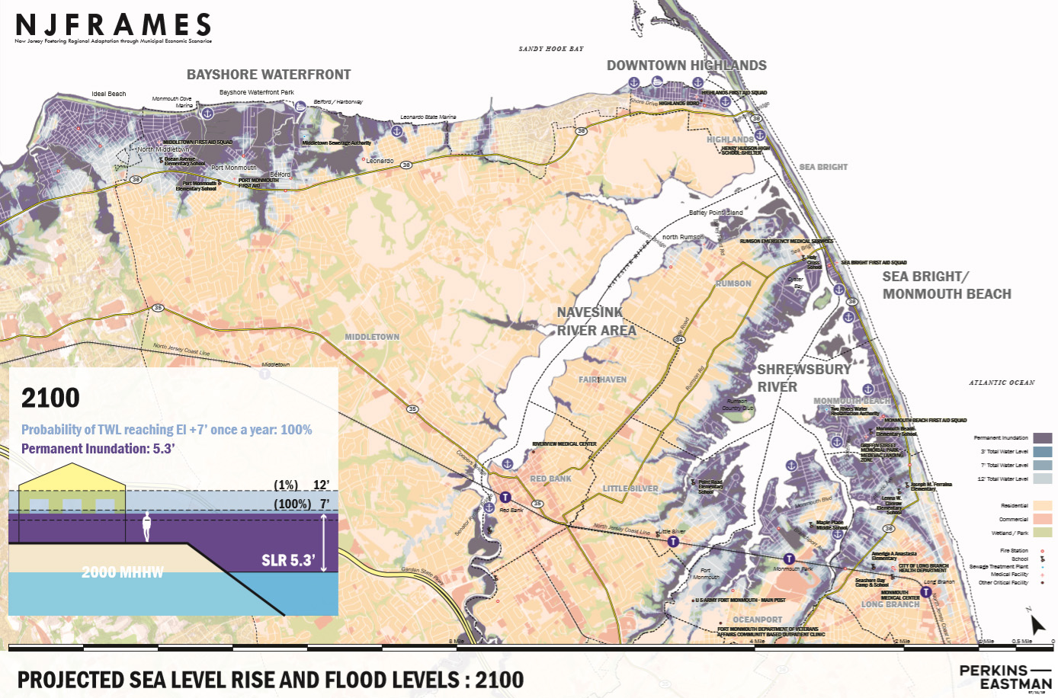
PROJECTED SEA LEVEL RISE-2100
Notes:
2100:
PURPLE: Sea Level
Dark Blue: 100% probability of 7 foot rise in water once per year
Light Blue: 1% probability of 12 foot rise once per year

Slide 52
Middletown 2020 Energy Plan Goals
Make Middletown 100% clean energy by 2050
  As per NJ Global Warming Response Act
  As per NJ Energy Master Plan
Achieve Sustainable Jersey Gold Star in Energy
Notes:
Edit to introduce Energy Plan.

Slide 53

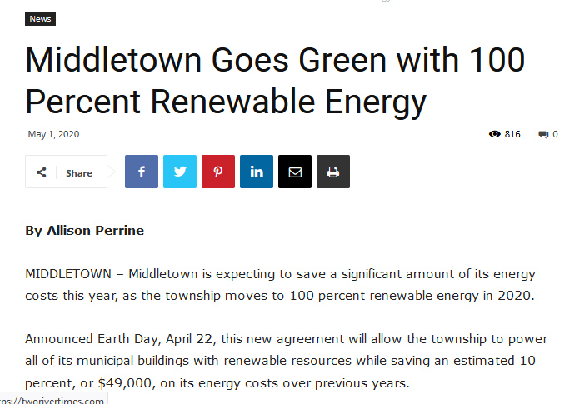
Notes:
MIDDLETOWN EARTH DAY APRIL 22 ANNOUNCEMENT
I will tell you a story. The point will be that You as a resident, need to help your OWN city Council or Committee
I skim thru the agenda for each Committee meeting
1 month before Earth Day, I noticed the committee was to vote on renewal of its STANDARD SUPPLIER for electricity for its municipal buildings
So I joined the meeting, and prodded the mayor – reminding him that he was committed to consider renewable electricity.
So the mayor asked the Middletown Administrator to look into it.
THE NEXT MEETING- the Committee was voting to adopt 100% renewable
I complimented the committee, and suggested they make a big splash.
AND THEY DID on EarthDay!!

Slide 54
Renewable Community Choice
Electric Aggregation
Town purchases electricity with greater renewable content for residents
  Better price; guaranteed for life of contract
  Cleaner electricity; increasing to 100% by 2030
  More consumer protection
Renewables are now cheaper than natural gas or nuclear and falling (by 95% in last 20 years)
Notes:
Edit to introduce Energy Plan.

Slide 55
Renewable Community Electric Aggregation
How It Works for Residents
Town states desired options; consultant goes out for bid.
Town chooses best supplier bid, enters 1-3 year contract.
Consultant provides customer support, incl. managing opt-ins & opt-outs & billing issues.
JCP&L provides physical grid/wiring service, & bills.
All residents are opted-in except
  Residents with home solar or 3rd party supplier contracts
  Businesses
All may change opt-in or opt-out at any time.
At end of contract, new bids are solicited.
Notes:
Edit to introduce Energy Plan.

Slide 56
Renewable Community Electric Aggregation
Towns That Have Contracted Jun2019-June2020
CITY | RENEWABLE CONTENT | RESIDENT SAVINGS
Essex Hub: South Orange, Glen Ridge, Maplewood, Montclair, Verona (PSE&G) | 41% | 10%
West Orange (PSE&G) | 100% | 5%
Glen Rock (PSE&G) | 100% | 8%
New Brunswick (PSE&G) | 2 options: 50% 100% | 10% 5%
Livingston: 2 (PSE&G) territories (JCP&L) | 100% ($.113/kwh) 41% ($.090/kwh) | $165 annual avg. 8%
Plainsboro (PSE&G) | 41% | $140 annual avg.
Red Bank (JCP&L) | TBD | TBD
Piscataway (PSE&G) | TBD | TBD
Princeton (PSE&G | 50% 100% | 3.4% 1.1% premium
Notes:
Edit to introduce Energy Plan.

Slide 57
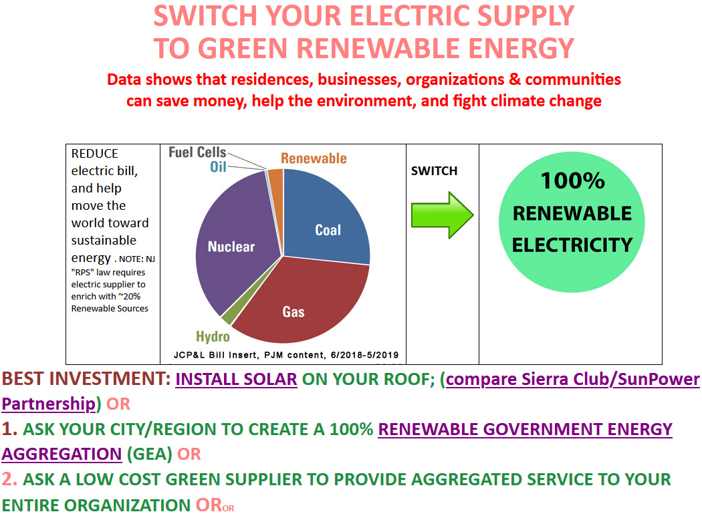
eLECTRIC.SMILLER.ORG

Slide 58
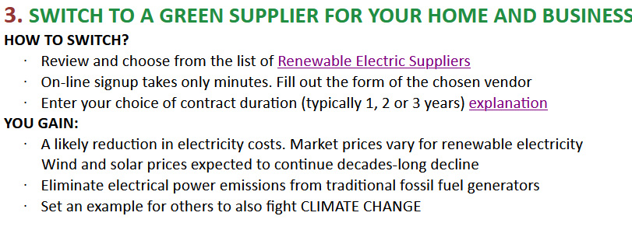
http://ELECTRIC.SMILLER.ORG

Slide 59
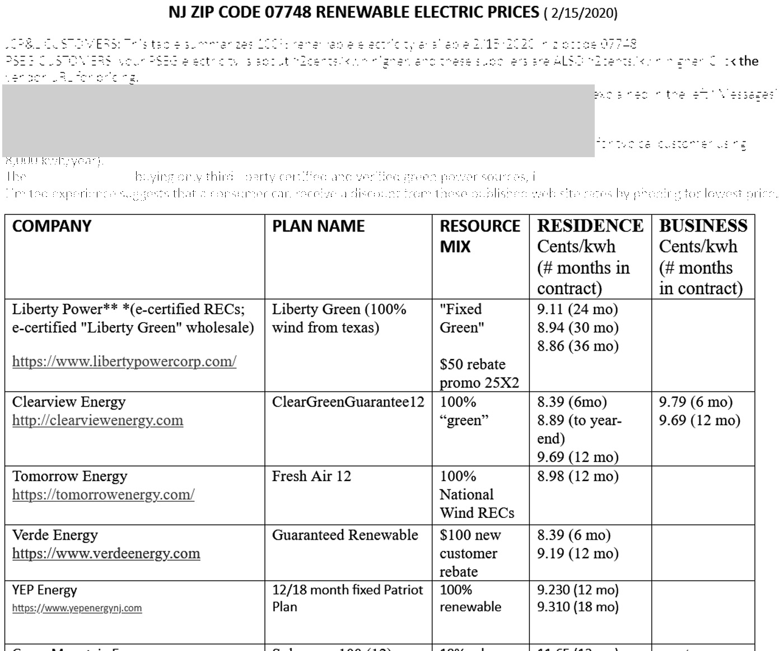

http://ELECTRIC.SMILLER.ORG

Slide 60


Slide 61
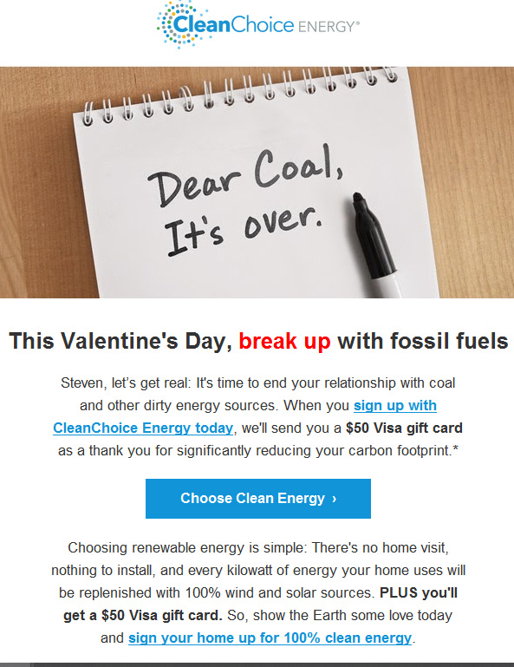

Slide 62


Slide 63
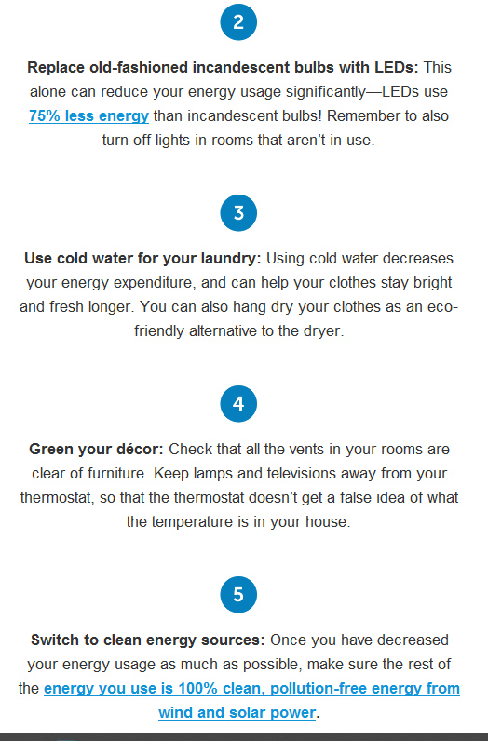

Slide 64
USE YOUR CHAT BOX
WHAT ONE GREATEST THING YOU CAN DO
(NOT DOING PRESENTLY)
TO LOWER YOUR GREEN HOUSE GASES
NAME ONE GREATEST THING YOU CAN DO
(NOT DOING PRESENTLY)
TO LOWER YOUR GREEN HOUSE GASES
RECORD IN CHAT BOX

Slide 65
Notes:
This Truth in Ten slide deck is available to the public, not just Climate Reality Leaders, to be used in noncommercial, nonpromotional presentations broadcast on TV, streamed online, and in-person, but this slide may not be modified.
TALKING POINTS:
Please join those who are speaking out, voting, and making everyday choices to fight the climate crisis.

Slide 66
Notes:
This Truth in Ten slide deck is available to the public, not just Climate Reality Leaders, to be used in noncommercial, nonpromotional presentations broadcast on TV, streamed online, and in-person, but this slide may not be modified.
TALKING POINTS:
Use your voice, your vote, and your choices in the marketplace and in your life.
Speak Truth to Power like your world depends on it.

Slide 67
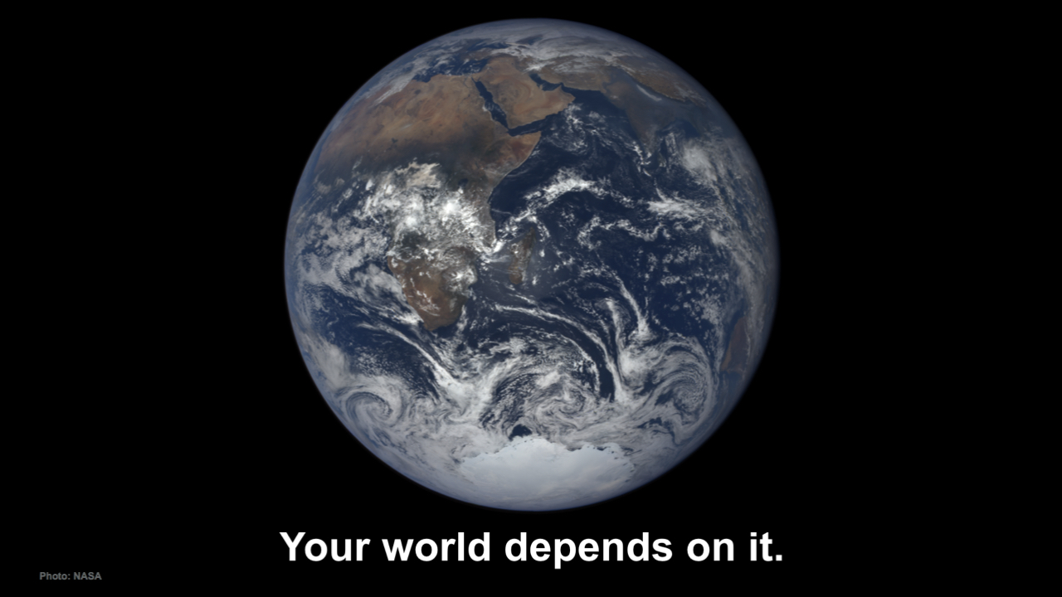
Notes:
This Truth in Ten slide deck is available to the public, not just Climate Reality Leaders, to be used in noncommercial, nonpromotional presentations broadcast on TV, streamed online, and in-person, but this slide may not be modified.
TALKING POINTS:
Because your world depends on it. We need your help.

Slide 68
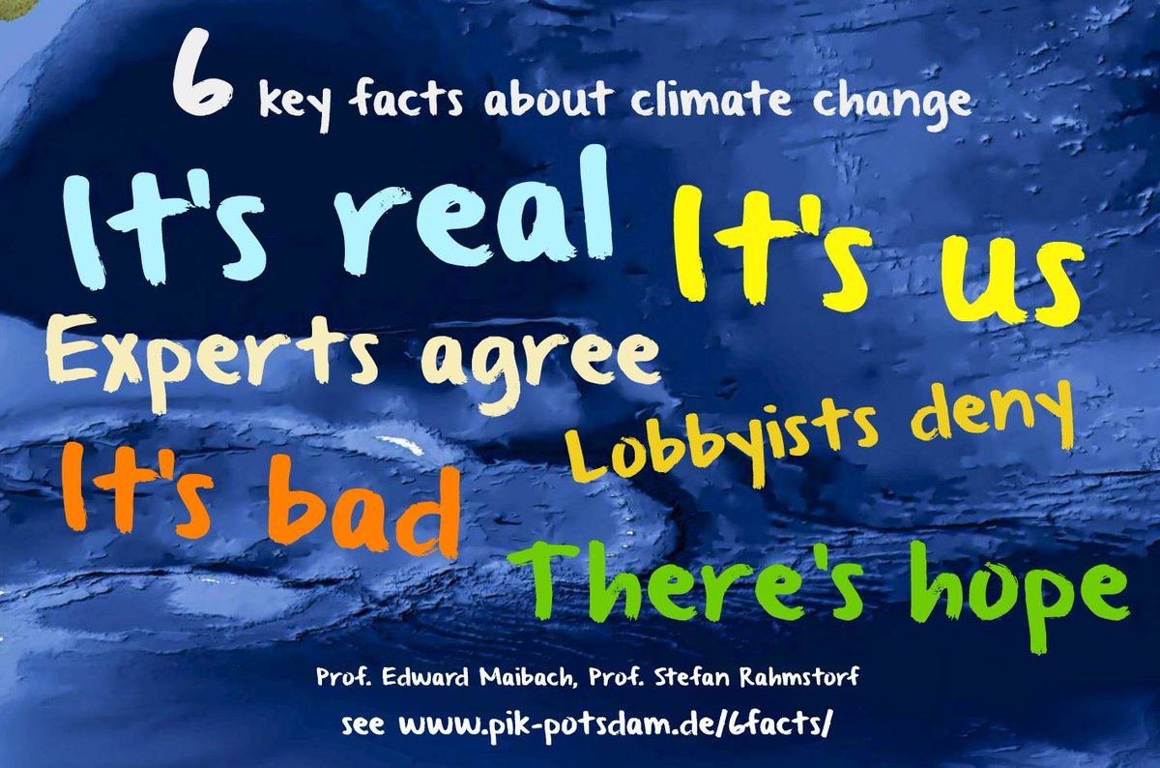
Notes:
This is the NJ “Footprint” of sources of world-heating Greenhouse gases, to show what to tackle first.
Sustainable Jersey states: “the primary goal [of “Gold Star in Energy” is reducing Green House Gases. Responding to this overarching imperative will help achieve all the other [sustainability] goals.”
20% of the GHG is from electricity generation; nearly 50% is from transportation.
Switching electricity to 100% wind/solar, then switching all vehicles to batteries charged by renewable electricity will ELIMINATE almost 70% of our GHG.
VERY IMPORTANT: -8% carbon sequestration by marshes, mudflats, trees, landscaping

Slide 69
WHAT TOPICS WOULD YOU LIKE TO SEE DISCUSSED
IN DETAIL AT A LATER DIALOG??
RECORD IN YOUR CHAT BOX
QUESTIONS?
USE YOUR CHAT BOX
WHAT ONE GREATEST THING YOU CAN DO
(NOT DOING PRESENTLY)
TO LOWER YOUR GREEN HOUSE GASES

